Slide 1


EXCALIBUR 2012
Developed By
Shobhit Saxena
National Institute of Technology, Kurukshetra
Roll Number: 111392
Branch : Information Technology
Batch : B.Tech. Ist Year
Mobile No: 9034493057

Slide 2
EXISTENCE OF UNIFIED ASCII CODE FOR ENGLISH FONTS
English Fonts are based on a common ASCII codes.
So, if you create a file on one font and open it on a computer where the font is not
Present, you can still see the data of the file correctly.
You can use substitute fonts available on that computer to open that file.
Next 2 slides will give you an idea about that.

Slide 3
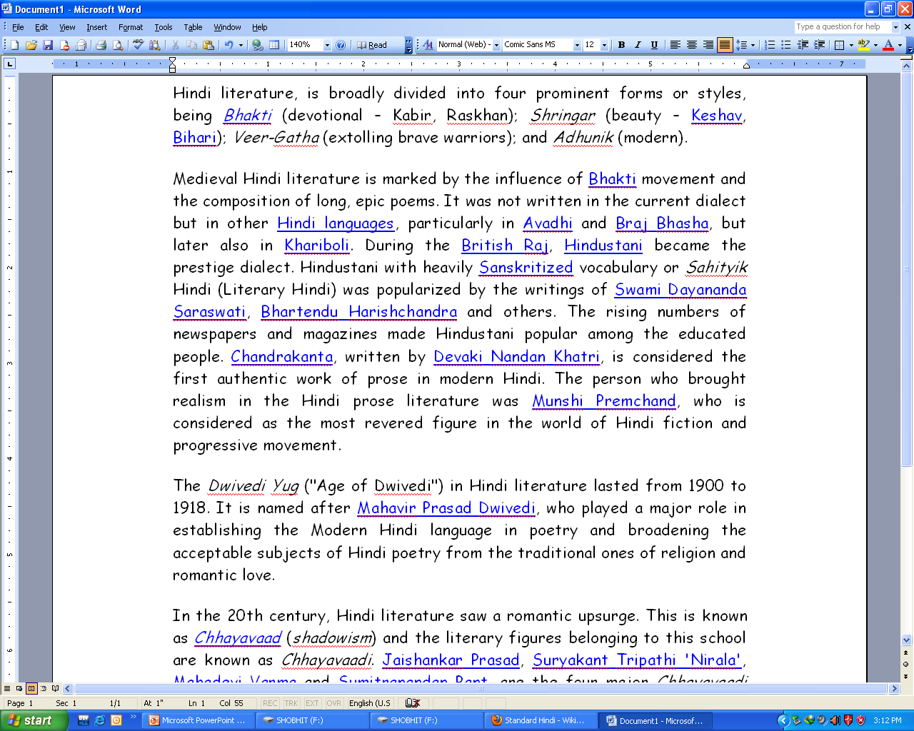
Below is a English file composed in “Comic Sans MS” font.

Slide 4
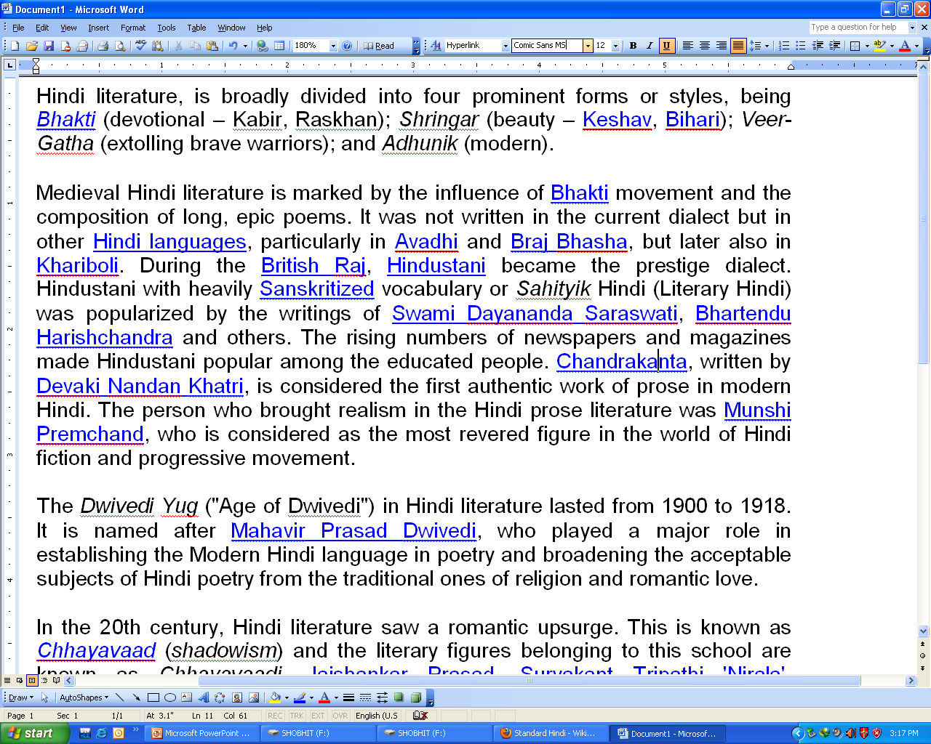
This happen when it is viewed on a computer that doesnot contain Comic Sans MS Font. We can correctly see the file. Although the style of font is changed but the data is readable.

Slide 5

We changed the font of the file to Arial. It also has no effect on the data. We can read it easily.

Slide 6
But the situation is not so with the Hindi Fonts. There are many fonts of Hindi available in the market. Each is based on its own code. Some are 8 bit fonts. Few are based on Unicode.
Non existence of a single code to represent Hindi creates a very big problem.
This is shown in the next few slides.
Lack of unified code for Hindi fonts

Slide 7
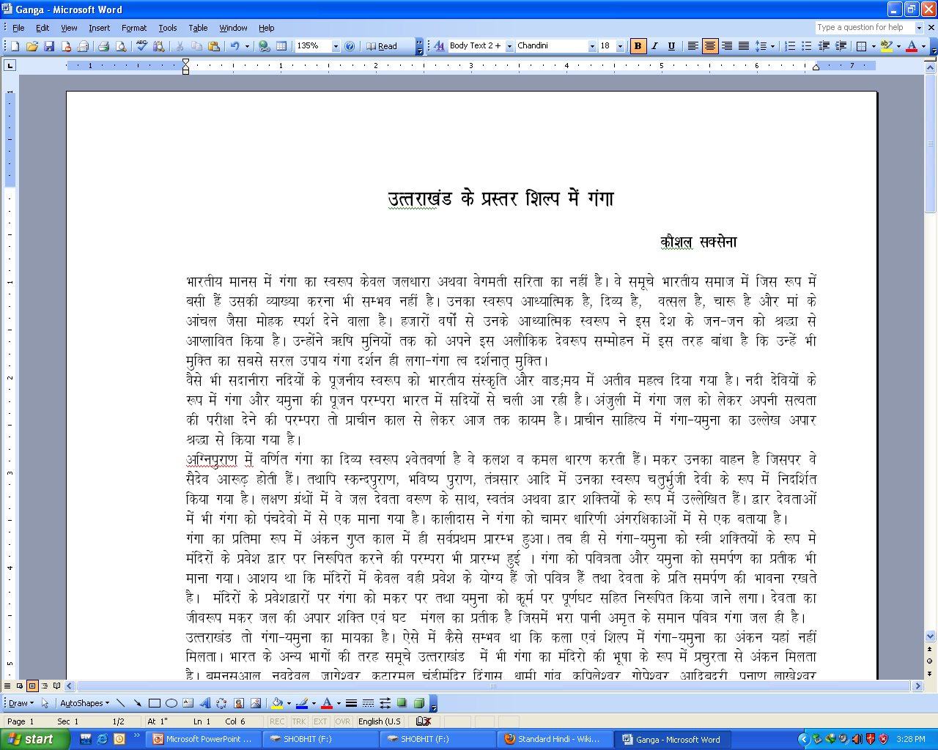
Below is an article composed in a Hindi font named “Chandini”.

Slide 8
Lets see how this file opens in a computer where this font is not present.

Slide 9
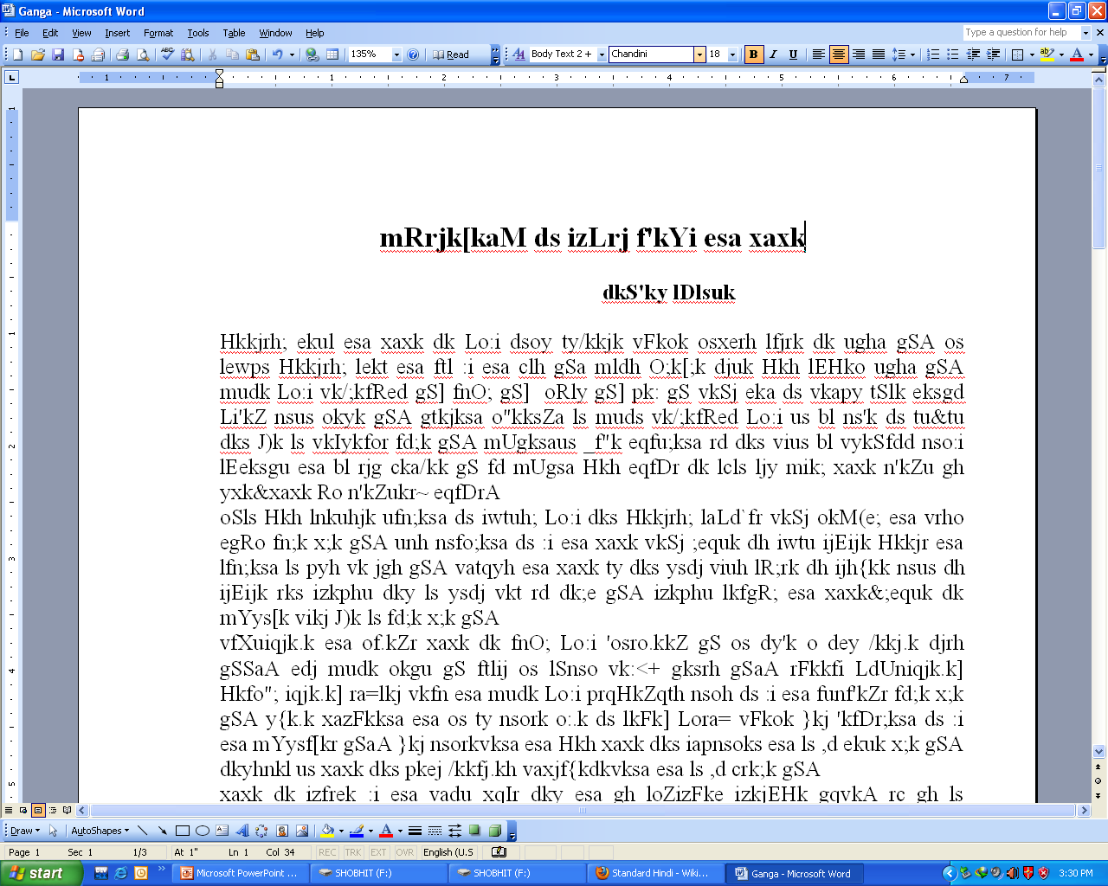
This is how the file looks in a computer where the font “Chandini” is not present. The file is not readable

Slide 10
Akhil708 is also a Hindi Font. Let see what happens when we use this font as a substitute.

Slide 11
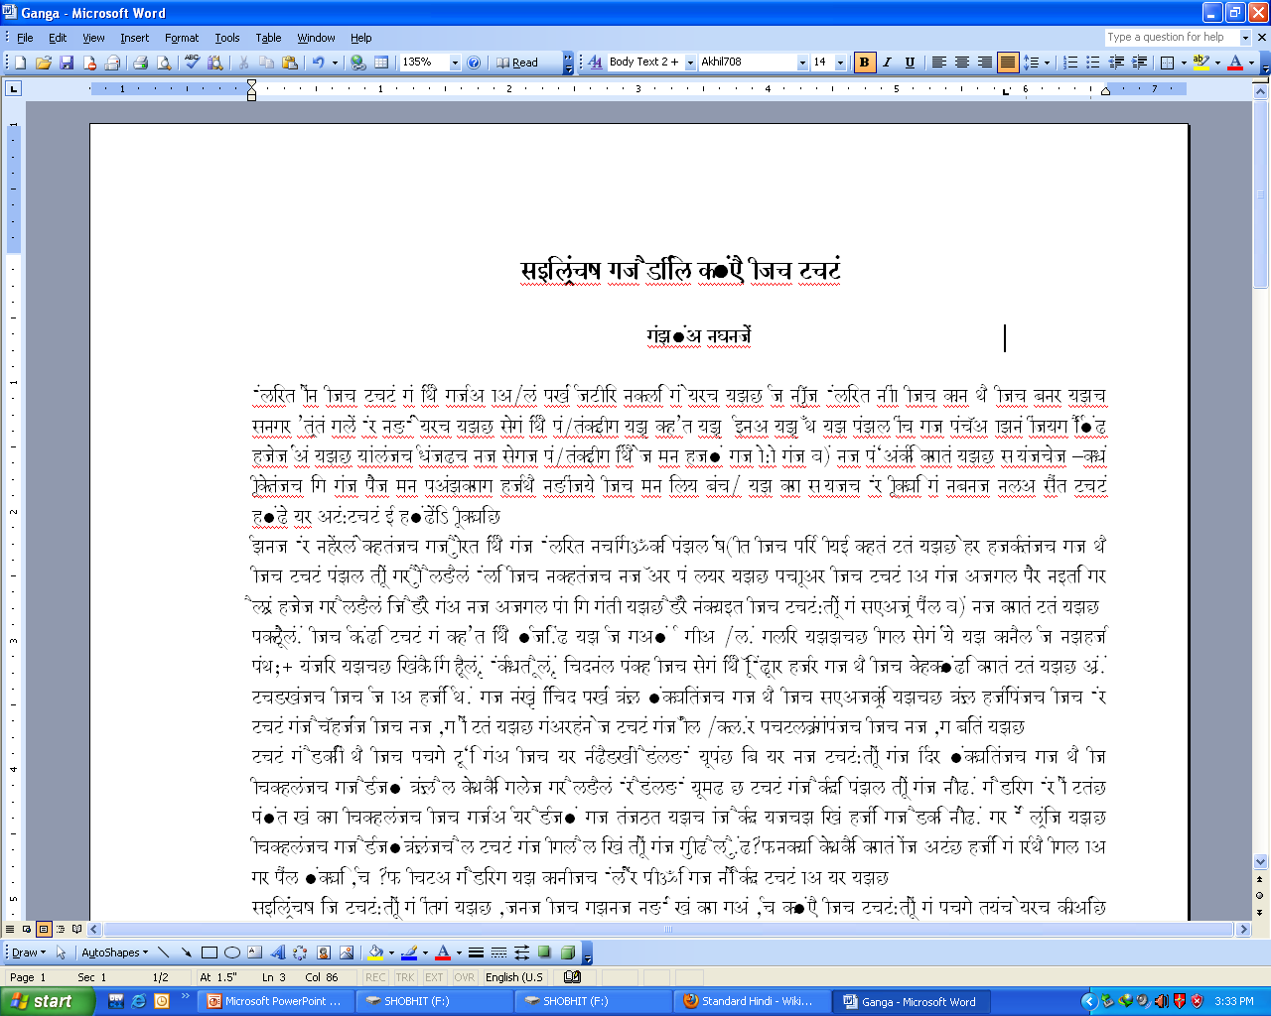
This is how the file looks when viewed in Akhil Font. The text is still not readable.

Slide 12
So the following problems occur with Hindi fonts due to the code mismatch.
To open a file one has to ensure whether the font is installed on one’s computer or not.
Hindi Websites have to supply their fonts to the user. For viewing their sites, the user must install that font on his computer.
Emails created in hindi fonts can be viewed on the other computer only if the font is available there.
Generally Hindi Fonts come with keyboard drivers. For composing text in different fonts one has to install keyboard drivers for all those fonts.
Text created on one computer can’t be edited on the other until the keyboard driver is present on that.
Many typing methods are available for writing Hindi e.g. phonetic, inscript, typewriter etc. Few fonts allow typewriter type input some allow others. A user can’t be perfect in all the typing styles.

Slide 13
Problem with the big Corporate
One of the main problem arises with the Media companies. They have a font in which they compile the data for their company. If they get data (it can be articles, advertisements, extracts etc) in any other font they have to recompile the whole data in their own font first.
The manual conversion is clumsy, time consuming, and more over very less accurate.
It is a wastage of both time, money and human resource.
If a file is received at the 0th hour, recompilation creates a mess at that time.
Companies are also afraid of shifting to the new Unicode fonts as all their data has to be recompiled in the new font.

Slide 14
About Agragami
Agragami is a software designed to make the use of Hindi Languages in IT & Media Industry ‘Simple and Convenient. Today, the entire IT and Media Industry is reeling with the problem of font’s mismatch due to the lack of unified code of Hindi fonts. Agragami Software resolves the problem by allowing easy inter-conversion of fonts in just a few clicks. It provide the user with an interface where the user can select the two fonts among which the conversion has to be done and the software converts the font.

Slide 15
Let’s see how Agragami works!!!

Slide 16
Features
Simple and faster conversion of one font to another with precision within a few secondss.
Easy to use wizard.
ConverDoc integration that allows user to convert .doc, .pdf, .htm, .rtf formats easily.
Command line integration that allows other software to integrate with and use our conversion algorithms.
Easy software editing that allows user to create his own font convertor.
SEND.DAT file that allows the user to report the errors in conversion.
No need to install the software. Carry it in pen drive.
Low disk space utilization. Can be run even from a 1.44 MB floppy disk.

Slide 17
Software Quality Attributes
Precision: The Agragami Font Converter performs the conversion with huge precision. The conversion is 100% accurate.
Time Efficiency: Thousands of characters can be converted in the desired font within a few seconds. Its speed is about 30,000 characters in only 0.06 seconds.
User Friendly: The Software has a user friendly interface for easy conversion of data.
Portability: The Software works efficiently with every 32 bit Operating System and has no additional hardware or peripheral requirements,
Low DIsk Usage: The actual software requires only 2.5 MB of hard disk space. Hence, one can run it in computers with low space.

Slide 18
Future Possibilities
The software will be allowed to integrate with the website servers. Now with every site, you will get an option regarding the font in which the site has to be displayed.
Moreover it will be integrated with the browser, document viewers allowing the user to view the data in any font.
A real-time convertor can be made which will automatically search the user’s computer for the text’s font. If the font is not found it will convert the font to the one present in user’s computer and display the data.

Slide 19
Potential Users
Every person dealing with Hindi is a potential user of Agragami Font Convertor.
Especially the companies dealing with Hindi language, media industry including newspaper corporate where the problem of mismatch of fonts prevails, can use the convertor for easy and precise conversion of fonts.
With the help of this software, the companies can also shift from their old conventional fonts to the modern one.

Slide 20
Queries…???

Slide 21
Thank You…

